Slide 1
Data Science HW1 Use python-matplotlib to plot some figures
Hsiang-Pin Hu
Advisor: Ming-Syan Chen

Slide 2
How to install python-matplotlib
Ubuntu:
sudo apt-get install python-matplotlib
or use pip to install
Other OS like Windows or Mac…:
You can try yourself!(google or ask other people)

Slide 3
Python-matplotlib
Reference:
http://myshare.dscloud.me/scipydoc/matplotlib_intro.html
http://liam0205.me/2014/09/11/matplotlib-tutorial-zh-cn/
http://matplotlib.org/api/pyplot_api.html

Slide 4
Plot what?
Iris dataset
Multivariate Statistical Analysis
(x, y) = (sepal length, sepal width), (sepal length, petal length), (sepal length, petal width), (sepal width, petal length), (sepal width, petal width), (petal length, petal width)
Different class with different colors and shapes
Figure title
x axis title and y axis title

Slide 5
iris dataset
Attribute Information:
1. sepal length in cm
2. sepal width in cm
3. petal length in cm
4. petal width in cm
5. class: Iris Setosa, Iris Versicolor, Iris Virginica
4.3,3.0,1.1,0.1,Iris-setosa

Slide 6
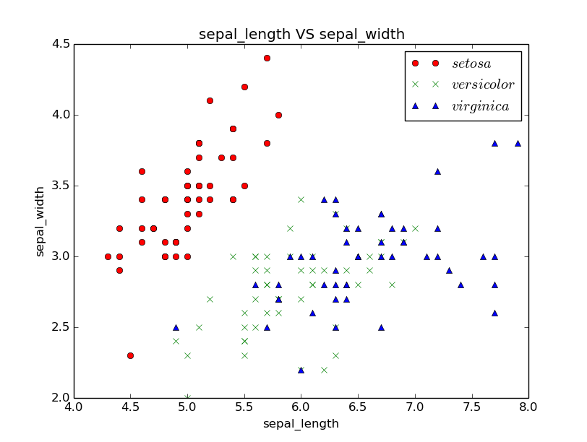
Example

Slide 7
TA test environment
Python 2.7(Ubuntu 14.04)
Directory:
hw1.py
Iris/
iris.data
iris.name
command:
python hw1.py

Slide 8
Files that you need to upload to ceiba(5%)
Student ID.zip
Student ID/
hw1.py
report.pdf

Slide 9
hw1.py(60%)
Generate six pictures at the same time

Slide 10
report.pdf(35%)
Six pictures
Your observation from six pictures

Slide 11
Due date
2015/10/20 23:59:59

Slide 12
Late policy
10% per day
No plagiarize

